Slide 1
COREX GLOBAL | 2024 PERFORMANCE REVIEW
Retail Sales & Customer Behavior Analysis

Slide 2
INTRODUCTION
This presentation covers Corex Global’s 2024 retail performance insights across sales, customers, products, and regions
The analysis followed a structured approach; database setup, SQL queries for KPI extraction, and Power BI visualization
The goal is to understand customer behavior, revenue drivers, and opportunities for strategic growth

Slide 3
OUTLINE
Introduction
Outline
Methodology
Results
Conclusion
Recommendations
Appendix & Next Steps

Slide 4
METHODOLOGY
Data Source: The dataset was adapted from real client data and subsequently refined using AI-driven techniques to ensure privacy and protect sensitive client information.
Database Design: Structured into relational tables(Customers, Products, Sales) in MySQL.
Data Processing: SQL queries used for aggregation and dataset preparation.
Analysis Tools: SQL for data extraction, Power BI for visualization.
Focus Period: Analysis is exclusively based on the full year of2024.

Slide 5
EXECUTIVE SUMMARY
Corex Global generated a total revenue of ₦501M in 2024 across 4,930 transactions
The company achieved an average order value of ₦101.6K, supported by 799 active customers during the focus year
Electronics was the leading product category, contributing more than 70% of total revenue
Kano, Ibadan, and Abuja emerged as the strongest contributors to customer revenue
Customer loyalty was strong, with 98% of sales coming from repeat buyers, showing high retention levels

Slide 6
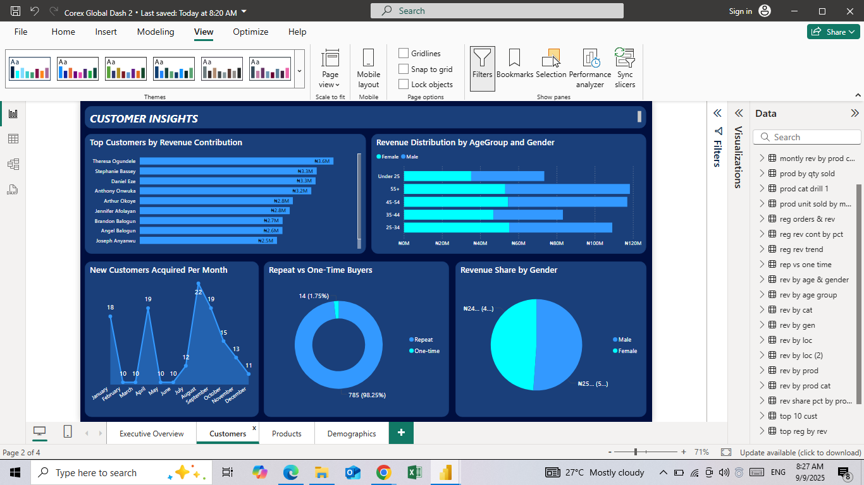
CUSTOMER INSIGHTS
The top ten customers generated a large share of total revenue.
New customer acquisition peaked in August 2024, coinciding with sales campaigns.
Repeat buyers made up 98% of purchases, highlighting strong retention.
Customers aged 25–44 were the most dominant group across both genders.

Slide 7
CUSTOMER INSIGHTS DASHBOARD

Slide 8
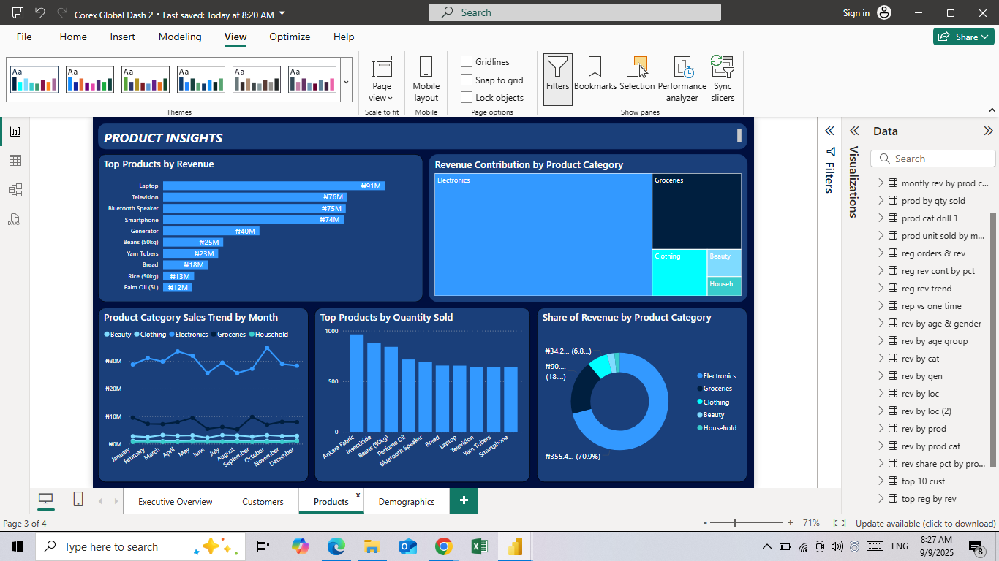
PRODUCT INSIGHTS
Laptops, televisions, and smartphones were the leading products.
Electronics generated more than 70% of total revenue in 2024.
Sales peaked in April and October, aligning with seasonal buying cycles.
Groceries and household items contributed less, showing diversification potential.

Slide 9
PRODUCT INSIGHTS DASHBOARD

Slide 10
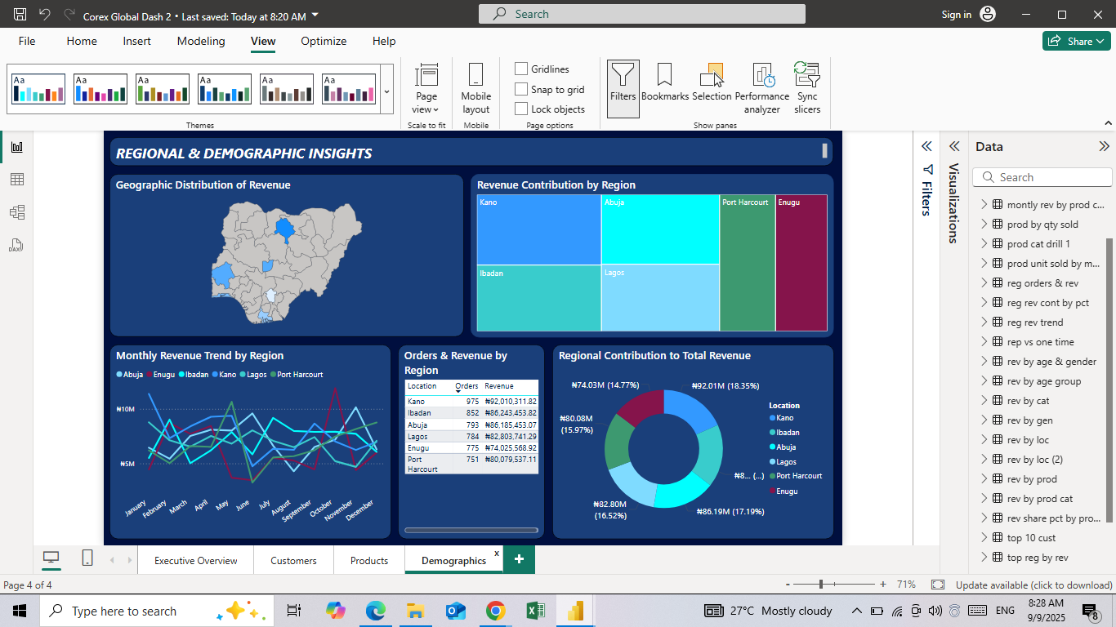
REGIONAL & DEMOGRAPHIC INSIGHTS
Kano, Ibadan, Abuja, and Lagos were the top-performing states.
Together, six regions contributed the majority of revenue.
Sales performance was concentrated in urban centers, limiting regional spread.
Kano and Lagos showed consistent monthly revenue trends.

Slide 11
REGIONAL & DEMOGRAPHICS DASHBOARD

Slide 12
CONCLUSIONS
Corex Global’s 2024 performance was driven primarily by electronics and urban centers.
Customer loyalty was exceptional, with repeat buyers making up nearly all transactions.
New customer acquisition showed growth but remained uneven across the year.
The company is well-positioned for growth, but diversification is essential for stability.

Slide 13
RECOMMENDATIONS
Strengthen electronics promotions and supply chain resilience.
Diversify into groceries and household categories to balance revenue.
Expand marketing efforts into mid-tier regions beyond urban centers.
Implement structured loyalty and retention programs.
Target marketing campaigns toward the 25–44 age demographic.

Slide 14
APPENDIX
SQL queries used to generate datasets and KPIs.
CSV files prepared from MySQL database.
Power BI dashboards designed across four themes.
Future steps include refining predictive insights and expanding category analysis.

